Slide 1
Lecture 3 – Xamarin.Forms Layouts
Mr. Yousif Garabet Arshak
Computer Science Department
University of Zakho
yousif.arshak@uoz.edu.krd

Slide 2
Outlines
Xamarin.Forms Layouts
Layouts with Single Content
ContentView
Frame
ScrollView
TemplatedView
ContentPresenter
Layouts with Multiple Children
StackLayout
Grid
AbsoluteLayout
RelativeLayout
FlexLayout

Slide 3
Xamarin.Forms Layouts
Xamarin.Forms Layouts are used to compose user-interface controls into visual structures.
The Layout and Layout<T> classes in Xamarin.Forms are specialized subtypes of views that act as containers for views and other layouts.
The Layout class itself derives from View.
A Layout derivative typically contains logic to set the position and size of child elements in Xamarin.Forms applications.

Slide 4
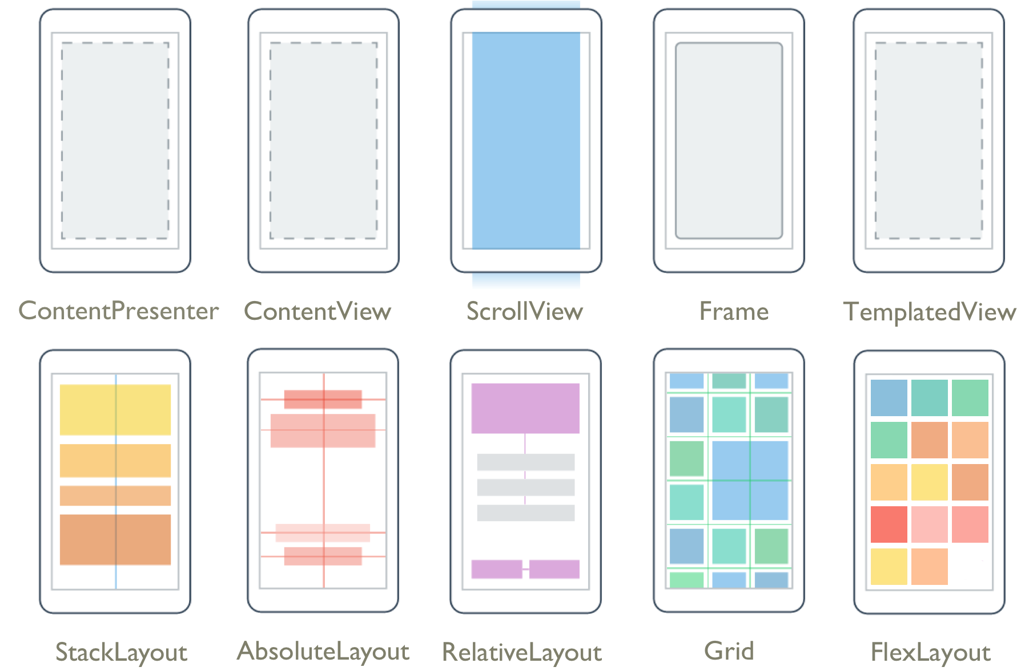
Xamarin.Forms Layouts

Slide 5
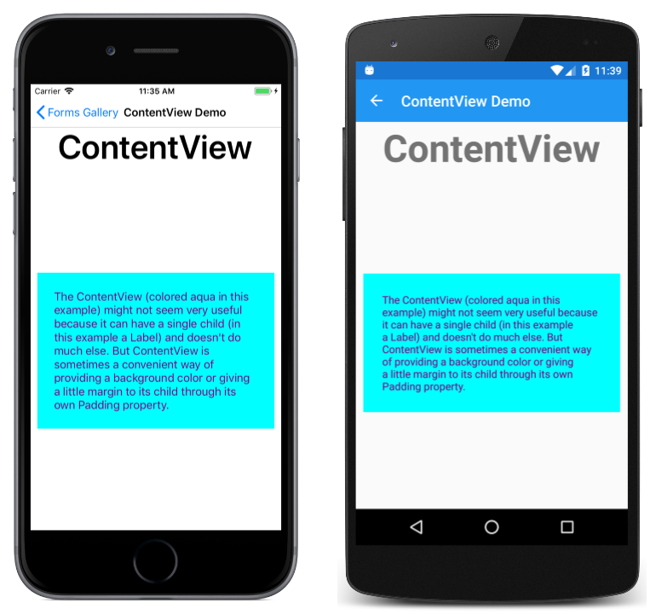
Layouts with Single Content
These classes derive from Layout, which defines Padding and IsClippedToBounds properties:
ContentView: ContentView contains a single child that is set with the Content property. The Content property can be set to any View derivative, including other Layout derivatives. ContentView is mostly used as a structural element and serves as a base class to Frame.

Slide 6
<?xml version="1.0" encoding="utf-8" ?>
<ContentPage xmlns="http://xamarin.com/schemas/2014/forms"
xmlns:x="http://schemas.microsoft.com/winfx/2009/xaml"
x:Class="FormsGallery.XamlExamples.ContentViewDemoPage"
Title="ContentView Demo">
<StackLayout>
<Label Text="ContentView"
FontSize="50"
FontAttributes="Bold"
HorizontalOptions="Center" />
<ContentView BackgroundColor="Aqua"
Margin="10"
Padding="25"
HorizontalOptions="Fill"
VerticalOptions="CenterAndExpand">
<Label Text= “some text here”
TextColor="Purple" />
</ContentView>
</StackLayout>
</ContentPage>
Xaml Code
Note: You can download all the XAML code in the this link:
Xamarin.Forms Layouts - Xamarin | Microsoft Docs

Slide 7
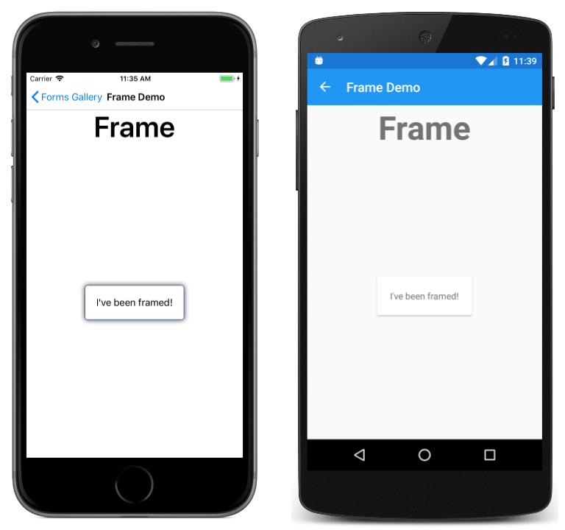
Frame: The Frame class derives from ContentView and displays a border, or frame, around its child. The Frame class has a default Padding value of 20, and also defines BorderColor, CornerRadius, and HasShadow properties.

Slide 8
Xaml Code
<?xml version="1.0" encoding="utf-8" ?>
<ContentPage xmlns="http://xamarin.com/schemas/2014/forms"
xmlns:x="http://schemas.microsoft.com/winfx/2009/xaml"
x:Class="FormsGallery.XamlExamples.FrameDemoPage"
Title="Frame Demo">
<StackLayout>
<Label Text="Frame"
FontSize="50"
FontAttributes="Bold"
HorizontalOptions="Center" />
<Frame OutlineColor="Accent"
HasShadow="True"
HorizontalOptions="Center"
VerticalOptions="CenterAndExpand">
<Label Text="I've been framed!" />
</Frame>
</StackLayout>
</ContentPage>

Slide 9
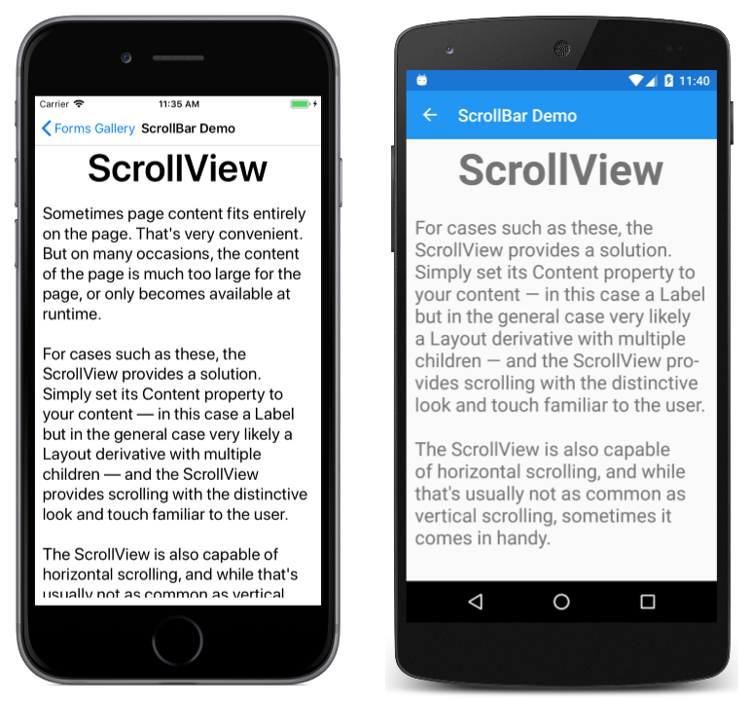
ScrollView: is capable of scrolling its contents. Set the Content property to a view or layout too large to fit on the screen. (The content of a ScrollView is very often a StackLayout.) Set the Orientation property to indicate if scrolling should be vertical, horizontal, or both.

Slide 10
Xaml Code
<?xml version="1.0" encoding="utf-8" ?>
<ContentPage xmlns="http://xamarin.com/schemas/2014/forms"
xmlns:x="http://schemas.microsoft.com/winfx/2009/xaml"
x:Class="FormsGallery.XamlExamples.ScrollViewDemoPage"
Title="ScrollView Demo">
<StackLayout>
<Label Text="ScrollView"
FontSize="50"
FontAttributes="Bold"
HorizontalOptions="Center" />
<ScrollView VerticalOptions="FillAndExpand"
Margin="10">
<Label Text=
"Sometimes page content.... “
FontSize="Large" />
</ScrollView>
</StackLayout>
</ContentPage>

Slide 11
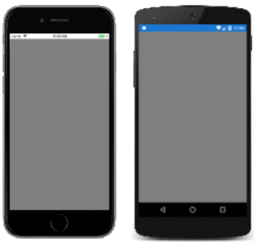
TemplatedView: TemplatedView displays content with a control template, and is the base class for ContentView.

Slide 12
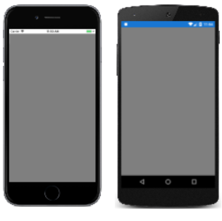
ContentPresenter: is a layout manager for templated views, used within a ControlTemplate to mark where the content that is to be presented appears.

Slide 13
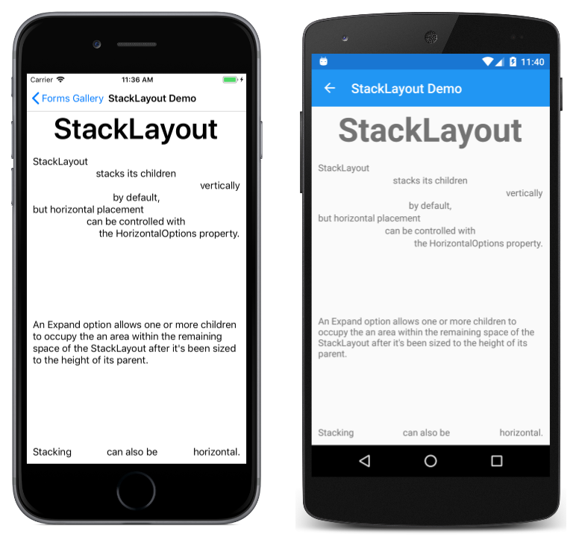
Layouts with Multiple Children
These classes derive from Layout<View>:
StackLayout: StackLayout positions child elements in a stack either horizontally or vertically based on the Orientation property. The Spacing property governs the spacing between the children, and has a default value of 6.

Slide 14
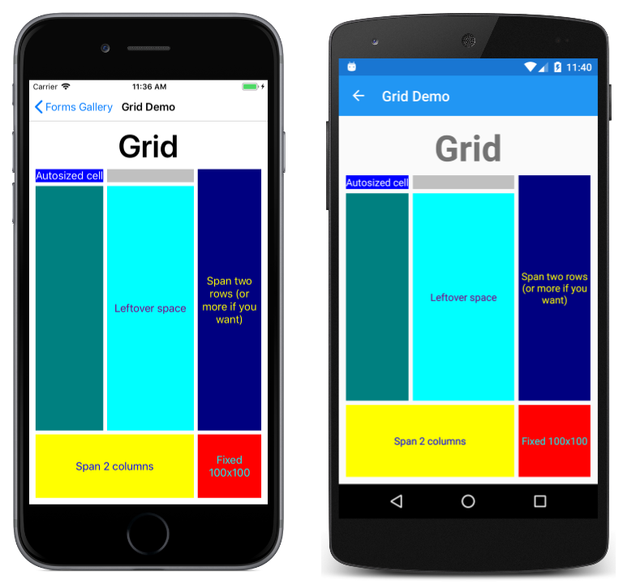
Grid: Grid positions its child elements in a grid of rows and columns. A child's position is indicated using the attached properties Row, Column, RowSpan, and ColumnSpan.

Slide 15
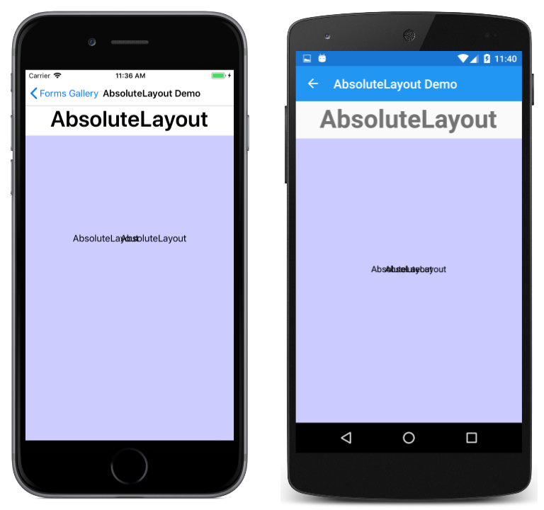
AbsoluteLayout: AbsoluteLayout positions child elements at specific locations relative to its parent. A child's position is indicated using the attached properties LayoutBounds and LayoutFlags. An AbsoluteLayout is useful for animating the positions of views.

Slide 16
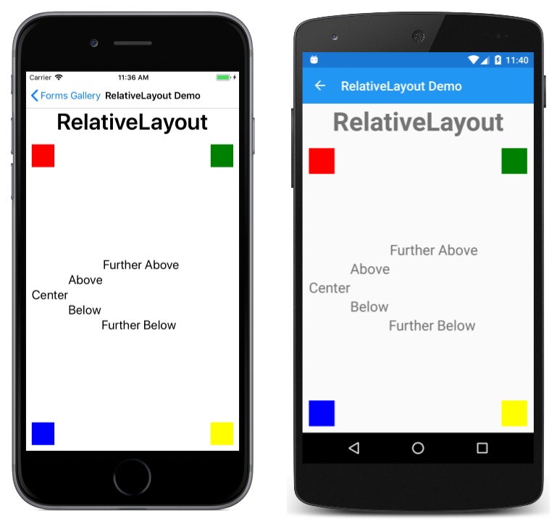
RelativeLayout: RelativeLayout positions child elements relative to the RelativeLayout itself or to their siblings. A child's position is indicated using the attached properties that are set to objects of type Constraint and BoundsConstraint.

Slide 17
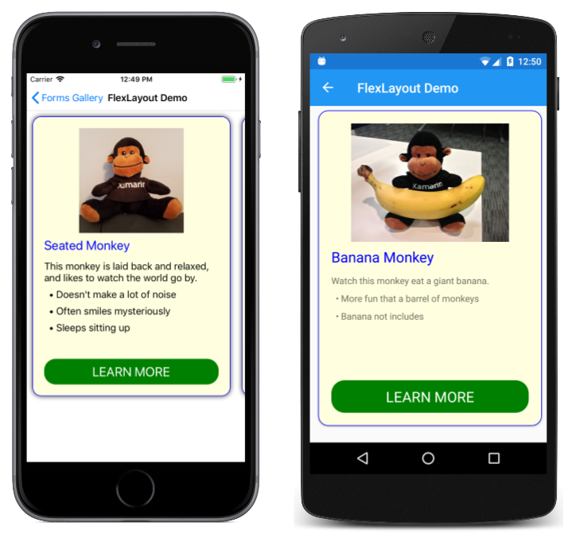
FlexLayout: FlexLayout is based on the CSS Flexible Box Layout Module, commonly known as flex layout or flex-box. FlexLayout defines six bindable properties and five attached bindable properties that allow children to be stacked or wrapped with many alignment and orientation options.

Slide 18

Any Questions?

